Slide 1



Ch 3.5: Nonhomogeneous Equations; Method of Undetermined Coefficients
Recall the nonhomogeneous equation
where p, q, g are continuous functions on an open interval I.
The associated homogeneous equation is
In this section we will learn the method of undetermined coefficients to solve the nonhomogeneous equation, which relies on knowing solutions to homogeneous equation.

Slide 2



Theorem 3.6.1
If Y₁, Y₂ are solutions of nonhomogeneous equation
then Y₁ - Y₂ is a solution of the homogeneous equation
If y₁, y₂ form a fundamental solution set of homogeneous equation, then there exists constants c₁, c₂ such that

Slide 3

Theorem 3.6.2 (General Solution)
The general solution of nonhomogeneous equation
can be written in the form
where y₁, y₂ form a fundamental solution set of homogeneous equation, c₁, c₂ are arbitrary constants and Y is a specific solution to the nonhomogeneous equation.

Slide 4

Method of Undetermined Coefficients
Recall the nonhomogeneous equation
with general solution
In this section we use the method of undetermined coefficients to find a particular solution Y to the nonhomogeneous equation, assuming we can find solutions y₁, y₂ for the homogeneous case.
The method of undetermined coefficients is usually limited to when p and q are constant, and g(t) is a polynomial, exponential, sine or cosine function.

Slide 5

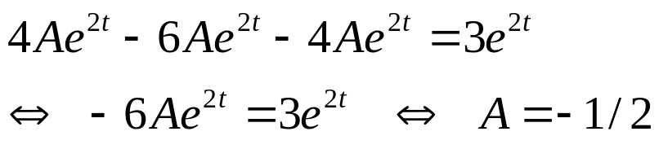
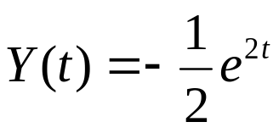
Example 1: Exponential g(t)
Consider the nonhomogeneous equation
We seek Y satisfying this equation. Since exponentials replicate through differentiation, a good start for Y is:
Substituting these derivatives into differential equation,
Thus a particular solution to the nonhomogeneous ODE is

Slide 6

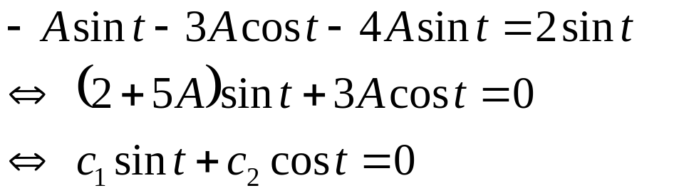
Example 2: Sine g(t), First Attempt (1 of 2)
Consider the nonhomogeneous equation
We seek Y satisfying this equation. Since sines replicate through differentiation, a good start for Y is:
Substituting these derivatives into differential equation,
Since sin(x) and cos(x) are linearly independent (they are not multiples of each other), we must have c₁= c₂ = 0, and hence 2 + 5A = 3A = 0, which is impossible.

Slide 7
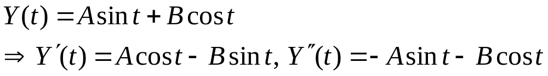
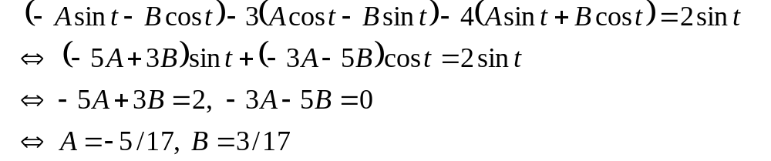
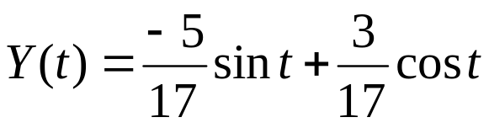
Example 2: Sine g(t), Particular Solution (2 of 2)
Our next attempt at finding a Y is
Substituting these derivatives into ODE, we obtain
Thus a particular solution to the nonhomogeneous ODE is

Slide 8

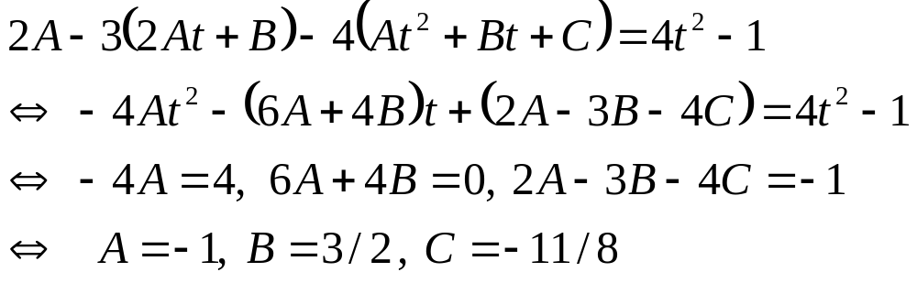
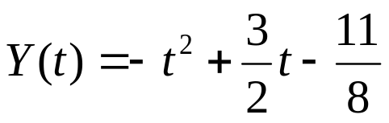
Example 3: Polynomial g(t)
Consider the nonhomogeneous equation
We seek Y satisfying this equation. We begin with
Substituting these derivatives into differential equation,
Thus a particular solution to the nonhomogeneous ODE is

Slide 9

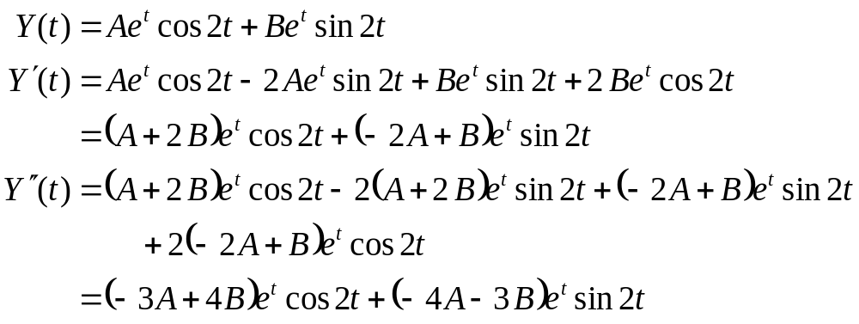
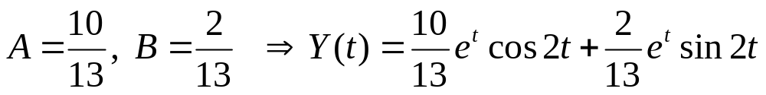
Example 4: Product g(t)
Consider the nonhomogeneous equation
We seek Y satisfying this equation, as follows:
Substituting derivatives into ODE and solving for A and B:

Slide 10


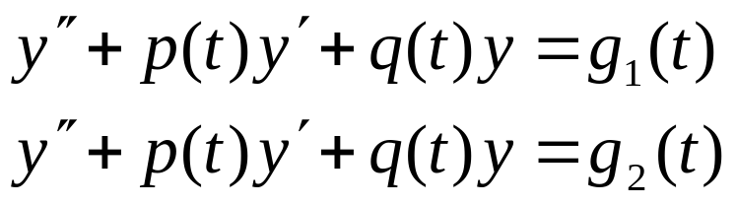
Discussion: Sum g(t)
Consider again our general nonhomogeneous equation
Suppose that g(t) is sum of functions:
If Y₁, Y₂ are solutions of
respectively, then Y₁ + Y₂ is a solution of the nonhomogeneous equation above.

Slide 11
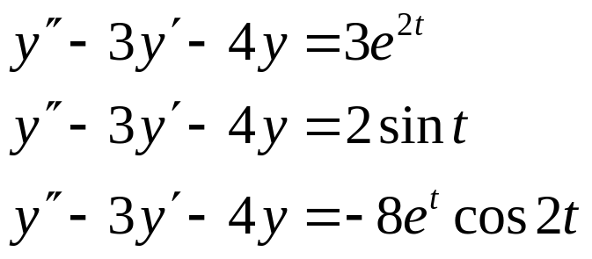
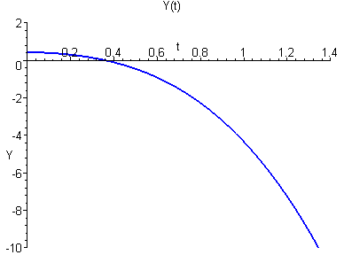
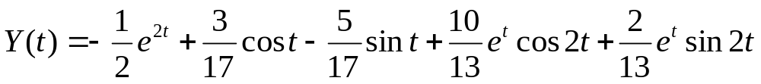
Example 5: Sum g(t)
Consider the equation
Our equations to solve individually are
Our particular solution is then

Slide 12

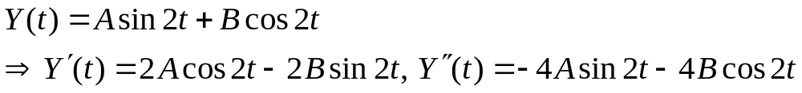
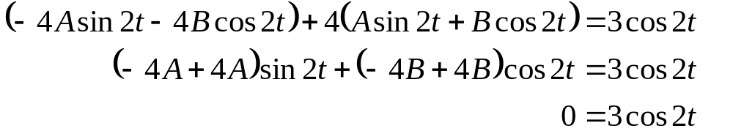

Example 6: First Attempt (1 of 3)
Consider the equation
We seek Y satisfying this equation. We begin with
Substituting these derivatives into ODE:
Thus no particular solution exists of the form

Slide 13

Example 6: Homogeneous Solution (2 of 3)
Thus no particular solution exists of the form
To help understand why, recall that we found the corresponding homogeneous solution in Section 3.4 notes:
Thus our assumed particular solution solves homogeneous equation
instead of the nonhomogeneous equation.

Slide 14
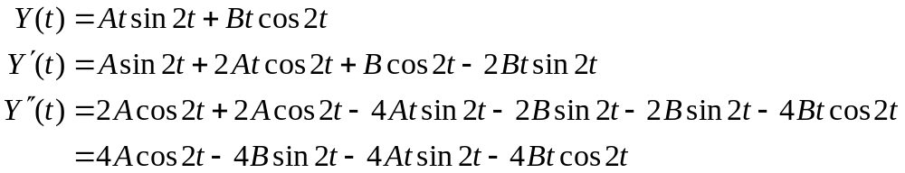
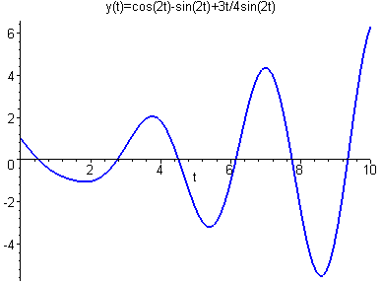
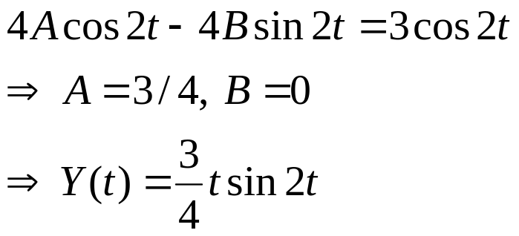
Example 6: Particular Solution (3 of 3)
Our next attempt at finding a Y is:
Substituting derivatives into ODE,

